Slide 1

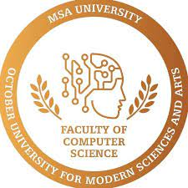

Assessing the quality of dental preparation using " Pixel matching and Image matching"
​Name : Habiba Adel
ID: 202457
Supervised by: Dr.Hesham Mansour
Dr.Alaa Naguib

Slide 2
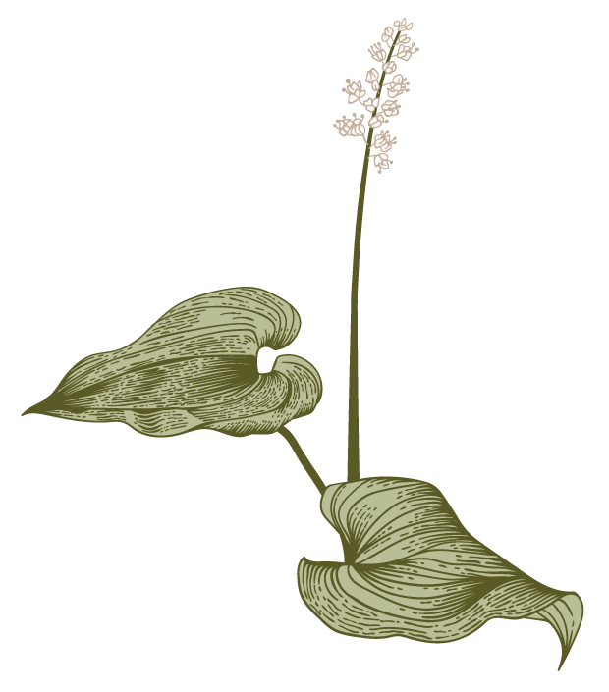

Agenda
Introduction 1/2
Introduction 2/2
Problem statement
Motivation
Objective
Related work 1
Related work 2
Data set
Approach
Expected outcomes
Requirement
References
A

Slide 3
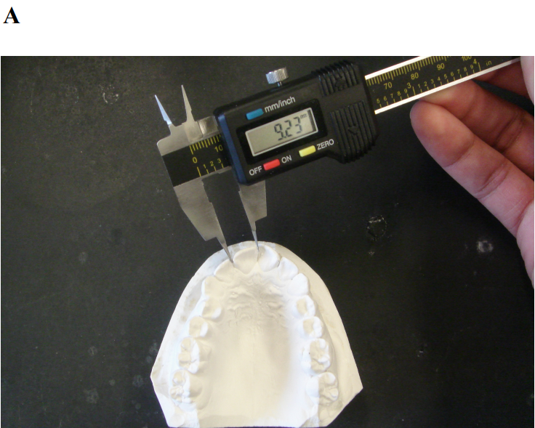
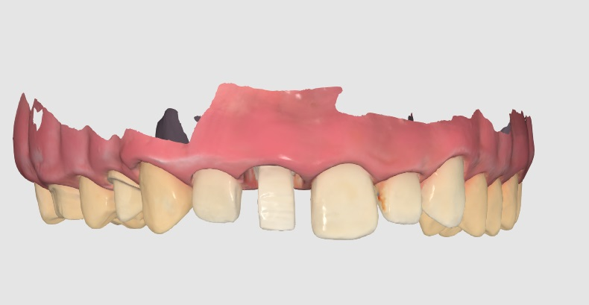
Introduction 1/2
Plaster Casts
Tooth width measurements on plaster casts have been found to be more error prone when there were three millimeters or more of dental crowding. Moreover, tooth-width measurements taken with needlepoint dividers have been found to be less reliable than those taken with a Boley gauge .[A]
Shellhart CW, Lane WD, Kluemper TG, Hicks PE (1995). Reliability of Bolton toothsize analysis when applied to crowded dentitions. Angle Orthod 65:327–334.
Student front view

Slide 4
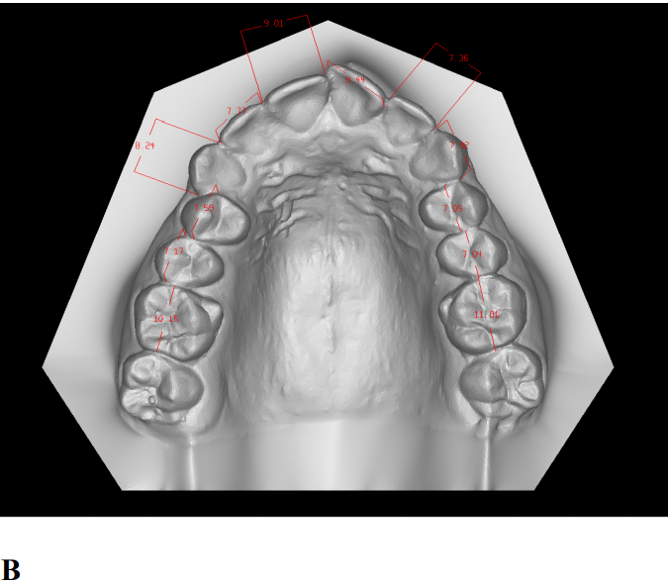
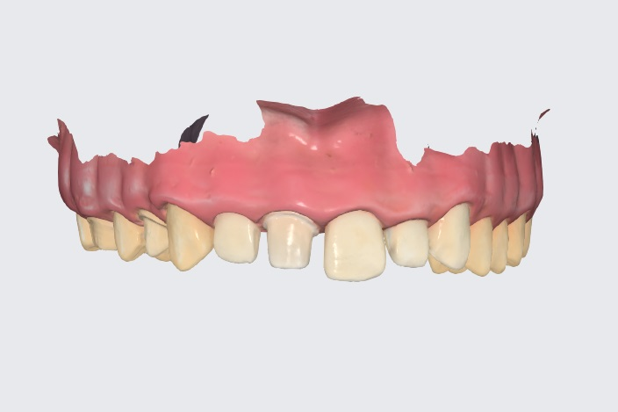
Introduction 2/2
Digital model
Studies have shown that the accuracy of digital scanners can vary depending on the specific scanner and the type of restoration being fabricated. Some digital scanners have been shown to have high accuracy levels, with deviations from the actual tooth surface being less than 50 microns. However, other scanners may have larger deviations, ranging from 100 to 300 microns.[B]
Shellhart CW, Lane WD, Kluemper TG, Hicks PE (1995). Reliability of Bolton toothsize analysis when applied to crowded dentitions. Angle Orthod 65:327–334.
Ideal image

Slide 5
Primary goals

Slide 6
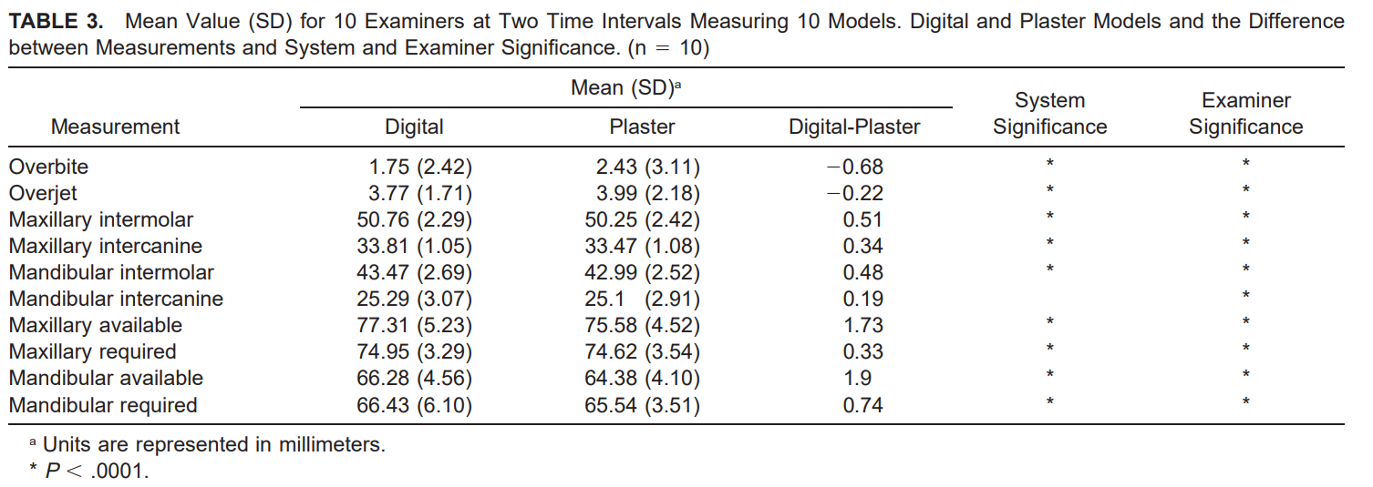
Problem Definition
The aim of this study is to investigate the level of inaccuracy between dental measurements taken in the traditional way , and those taken using a digital scanner. Specifically, we will explore whether there are significant differences in measurements of tooth size, interdental spaces, and occlusion between the two methods.

Slide 7
Motivation
Investigating the level of inaccuracy between dental measurements taken by dental students using traditional methods and those taken using a digital scanner is important for improving the quality of dental education. The results of this study can help identify any potential limitations of traditional methods used by dental students and provide insight into the accuracy of digital scanners in the hands of inexperienced users.
In addition to improving the quality of dental education, the results of this study can have practical implications for dental practices. Dental students are often involved in patient care, and if their measurements are inaccurate, it can lead to additional costs associated with repeat treatments or adjustments. Therefore, it is important to investigate the accuracy of dental measurements taken by dental students and identify any potential areas for improvement in their training.

Slide 8
Objective
“
To evaluate the validity and reproducibility of dental measurements performed on 3D digital study models using an intraoral scanner and compare them with measurements obtained using the traditional method.
”

Slide 9
Previous studies have investigated the accuracy of dental scanners in comparison to traditional methods. One study by Kim et al. (2018) found that dental scanners produced more accurate measurements than traditional methods, particularly for measuring inter-arch distances. However, another study by Lee et al. (2019) found that there was no significant difference in the accuracy of measurements obtained through scanners and traditional methods.
​Related work 1

Slide 10
Related work 2
Another study by Jeong et al. (2021) investigated the accuracy of dental measurements taken by dental students through traditional methods. The study found that there were variations in the accuracy of measurements taken by different students, indicating a need for standardized training in dental universities.

Slide 11
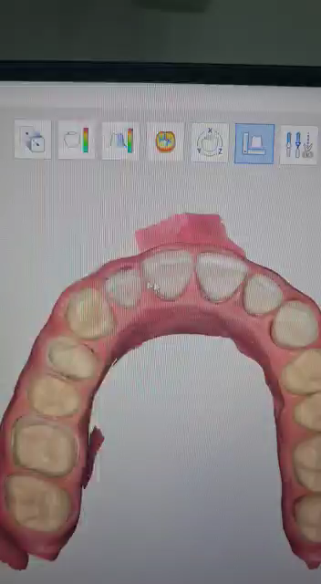
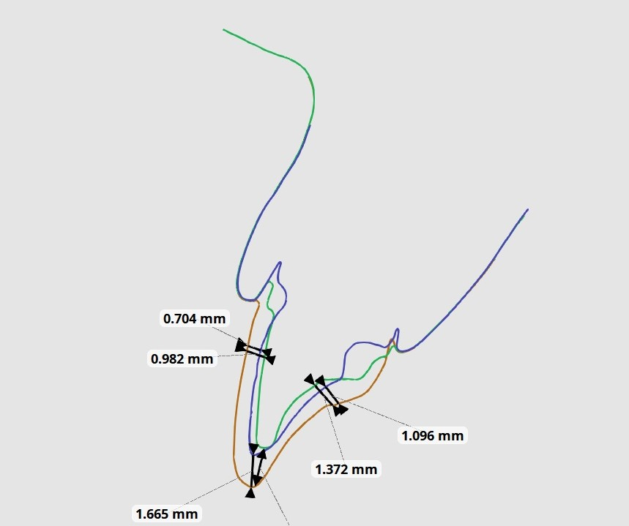
Data set
We plan to collect data from dental students who will take measurements through conventional methods and using a dental scanner. The data collected will include measurements taken through both methods, and we will use statistical analysis to compare the accuracy of these measurements using two 3D images relative to the original image.
Red is before preparation,
Blue is ideal and green is student preparation.

Slide 12
Approach
Our approach involves collecting data from dental students who will take measurements through conventional methods and using a dental scanner. We will then use statistical analysis to compare the accuracy of these measurements. We plan to use the Python programming language for data analysis and 3D visualization and use
three technologies:
Pixel matching.
Image matching.

Slide 13
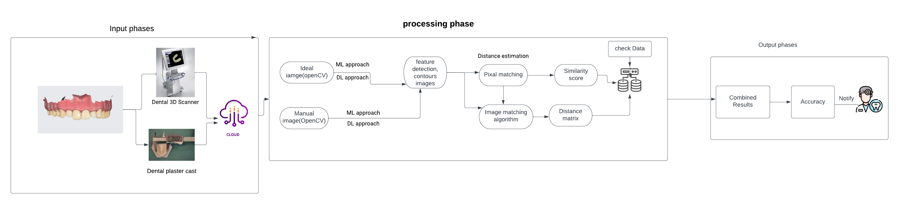
System overview

Slide 14
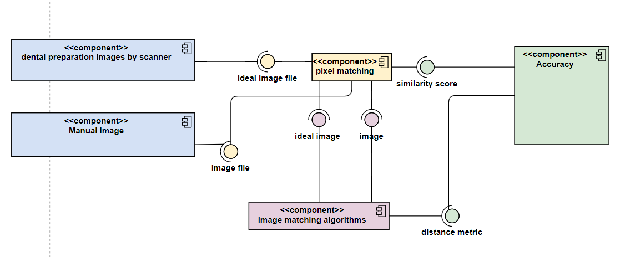
Component diagram

Slide 15
Expected outcomes
we expect to identify any significant differences in the accuracy of dental measurements obtained with conventional methods and with a dental scanner. This will help determine how well the student achieves perfect form, applies grading ceriateria, and gets the student the grade he or she deserves with every point achieved.

Slide 16
Requirement
The project will require dental students who will take measurements through traditional methods and with the use of a dental scanner. We will also need access to dental scanners and traditional dental measurement tools. We will use Python programming language for data analysis and visualization.

Slide 17
plan
Collect data from dental students who will take measurements through traditional methods and with the use of a dental scanner.
Analyze the data using statistical analysis.
Visualize the results using Python programming language.
Compare the accuracy of measurements obtained through traditional methods and with the use of a dental scanner.
Determine the effectiveness of dental scanners in comparison to traditional methods.

Slide 18
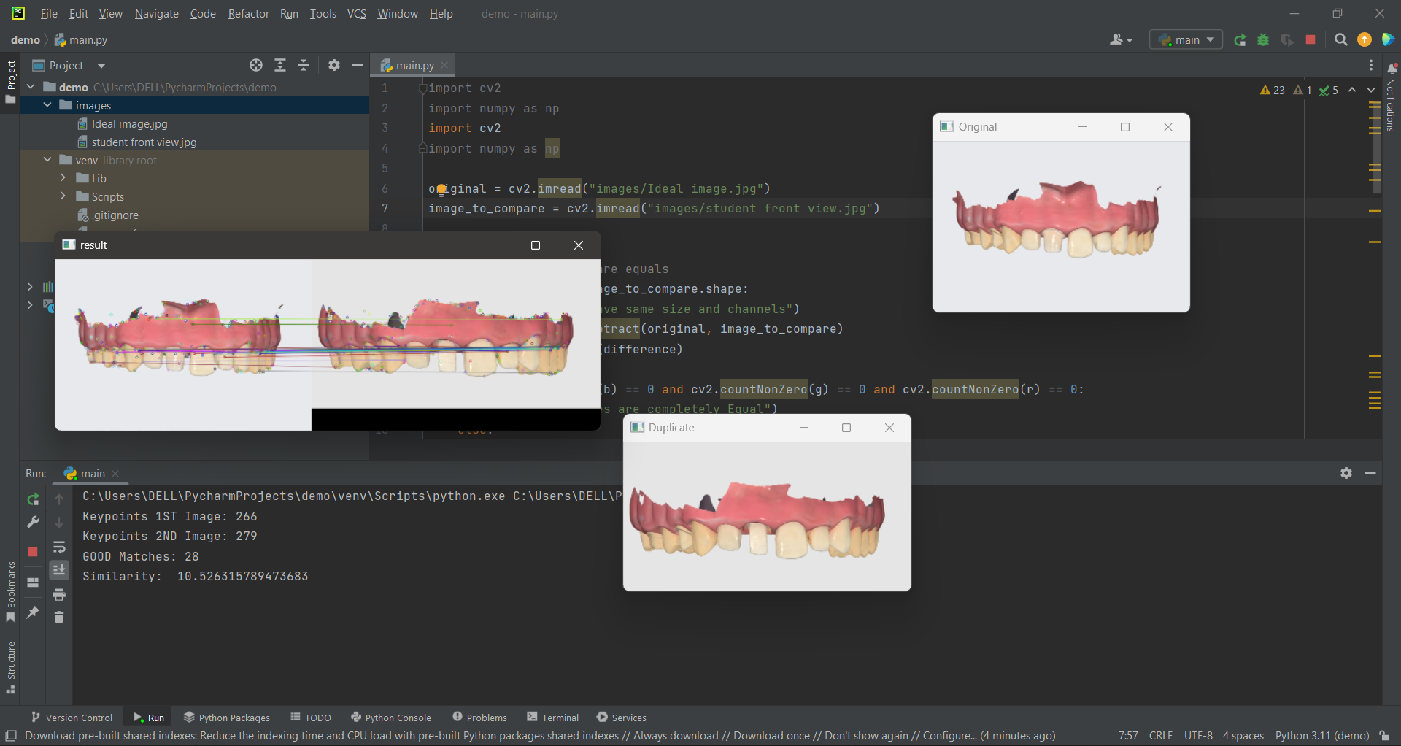
Result

Slide 19
References
Kim, J. H., Kim, K. B., Kim, W. C., & Kim, J. H. (2018). Accuracy of intraoral digital impressions using an artificial landmark. Journal of prosthodontic research, 62(3), 346-351.
Lee, M., Kim, H. K.,
Shellhart CW, Lane WD, Kluemper TG, Hicks PE (1995). Reliability of Bolton toothsize analysis when applied to crowded dentitions. Angle Orthod 65:327–334.

Slide 20
Thank you
Name: Habiba Adel Sayed
Email:Habiba.adel2@msa.edu.eg
GitHub: https://github.com/Habiba07121999/Project_Grad1_SE

